Slide 1

Participant number: (Total n=61)
Cleaned data with: excluding RT>4000,RT<180 (consistent with what Rui did)
CMat: Alternative trials
MiX: mix AN/CM with 8 CM on each side
MIX2: mix an/cm with 4 cm on each side
ANpure: pure AN
CMpure: pure CM

Slide 2
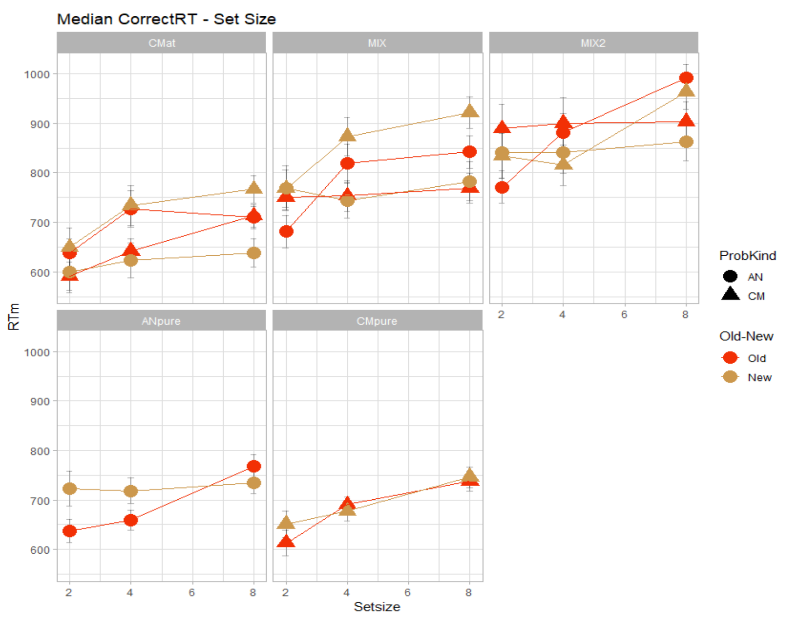
Median correct RT
CMat: Alternative trials
MiX: mix AN/CM with 8 CM on each side
MIX2: mix an/cm with 4 cm on each side
ANpure: pure AN
CMpure: pure CM

Slide 3
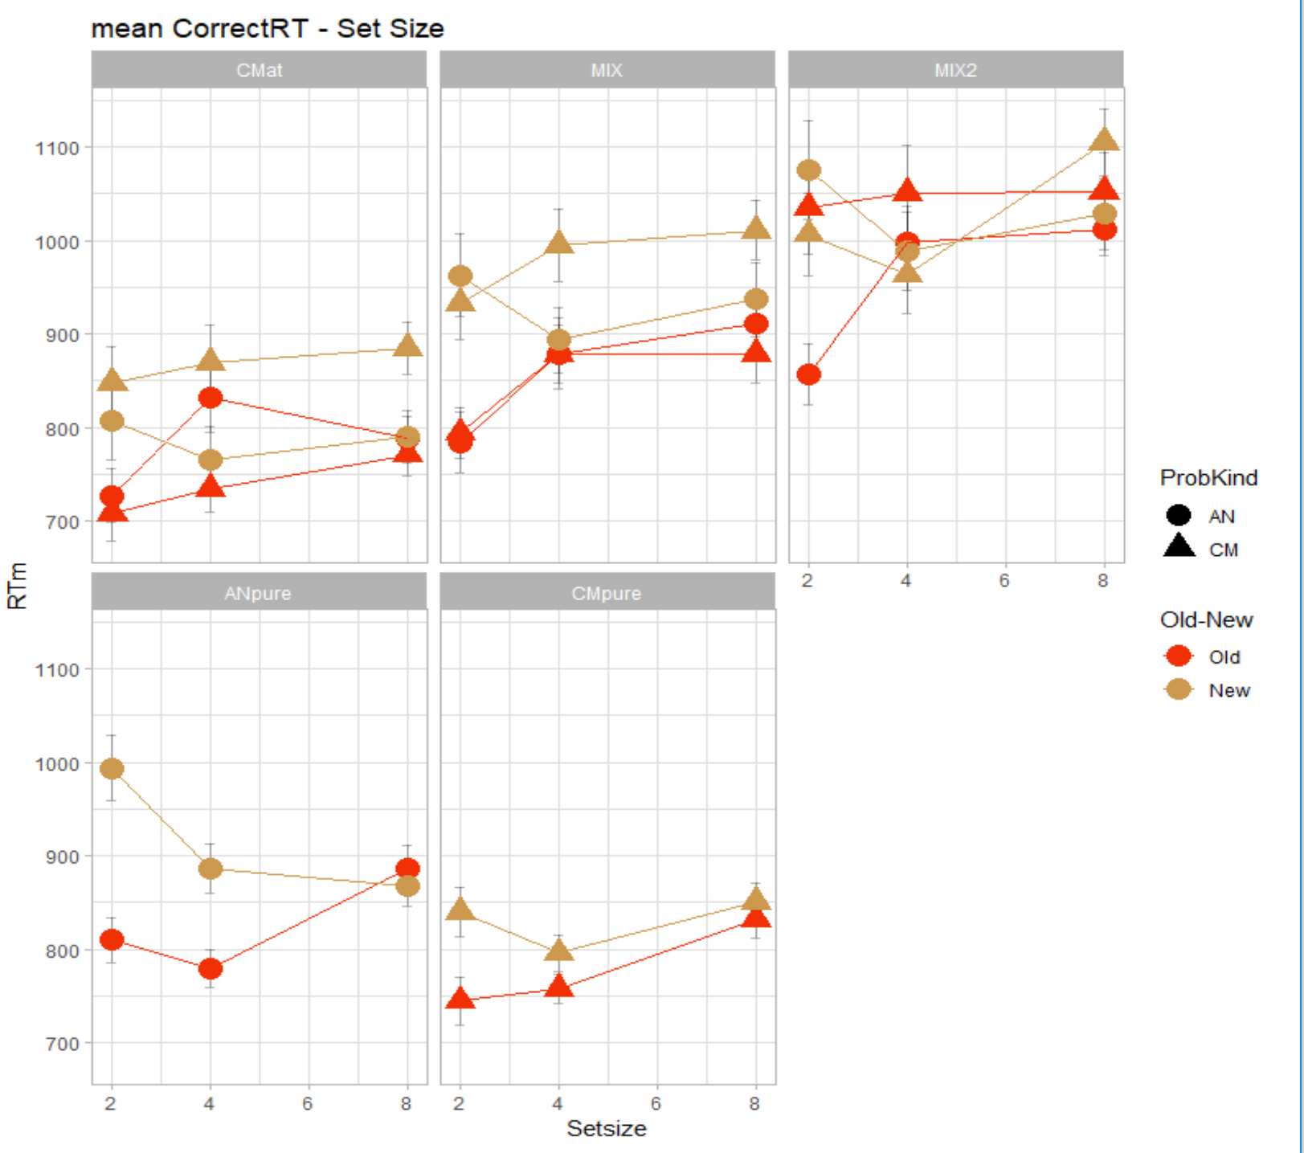
Mean correct RT
CMat: Alternative trials
MiX: mix AN/CM with 8 CM on each side
MIX2: mix an/cm with 4 cm on each side
ANpure: pure AN
CMpure: pure CM

Slide 4
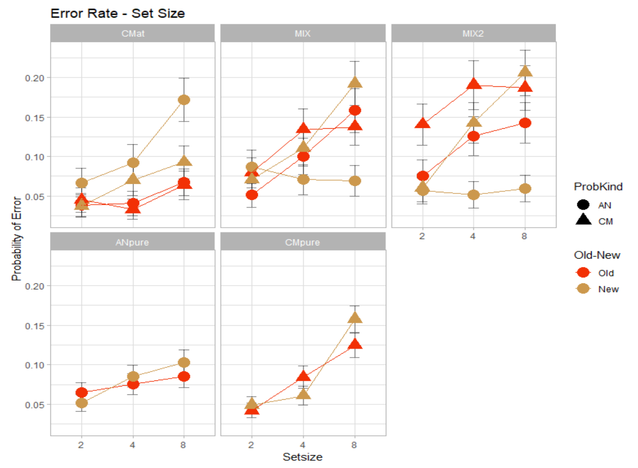
Error Rate
Error rate plot for different blocks are similar, so not presented here
CMat: Alternative trials
MiX: mix AN/CM with 8 CM on each side
MIX2: mix an/cm with 4 cm on each side
ANpure: pure AN
CMpure: pure CM

Slide 5
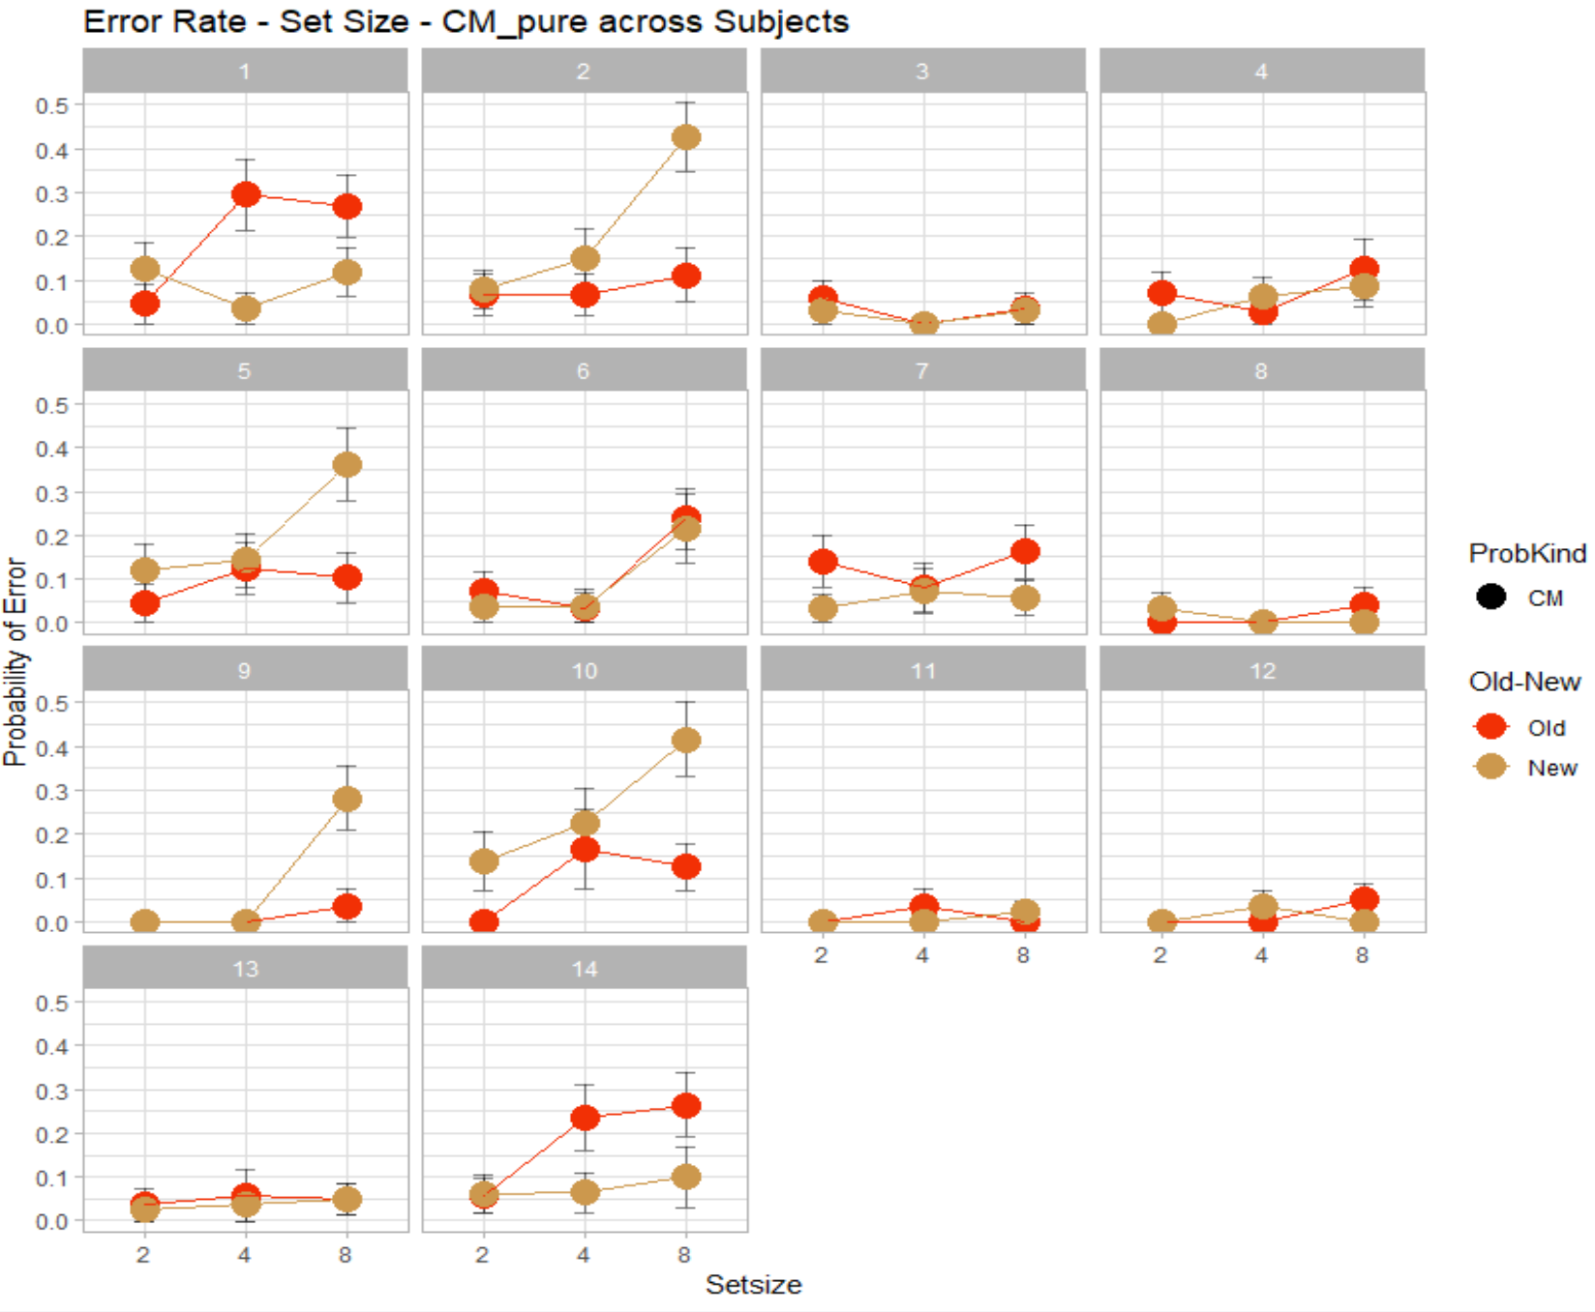
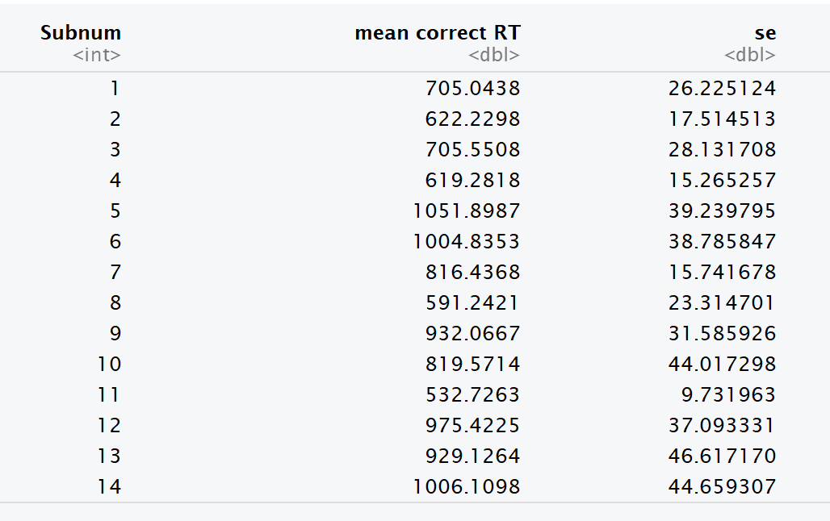
Error Rate for CM pure across Subjects (2-14)
Correct RT summary for each participant in CM pure

Slide 6
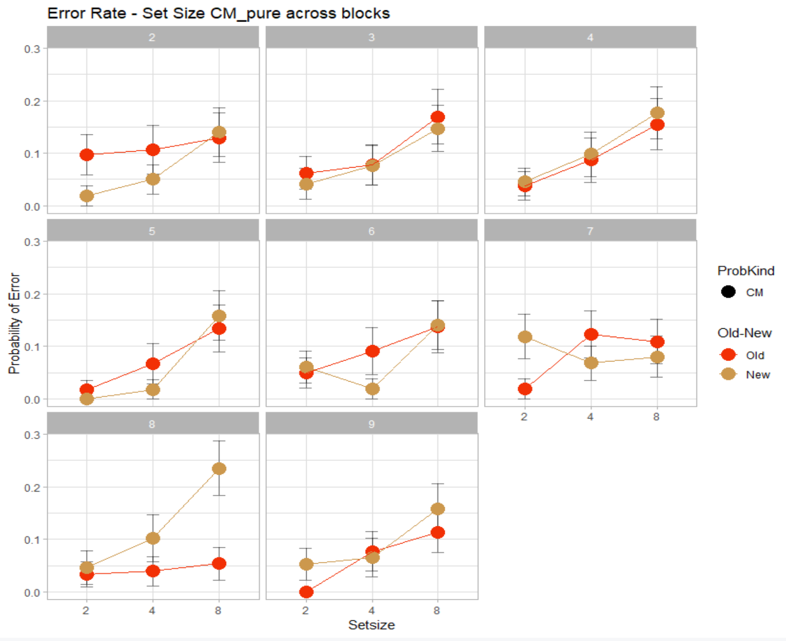
Error Rate of CM pure across blocks (2-9)

Slide 7
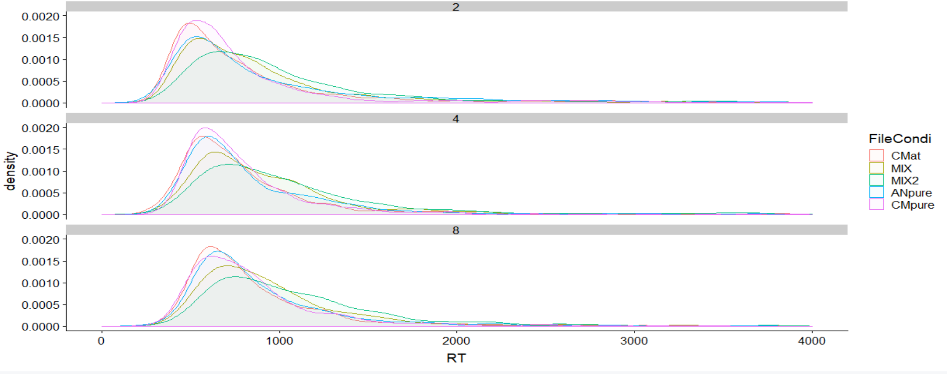
Density plots for RT (for setsize 2,4,8)
CMat: Alternative trials
MiX: mix AN/CM with 8 CM on each side
MIX2: mix an/cm with 4 cm on each side
ANpure: pure AN
CMpure: pure CM

